Slide 1

CPU Scheduling
PASS
All looks good now
CS532: OS Foundations
Lab Assignment
Email address: faiyaz@pdx.edu
Partners email address: boyapati@pdx.edu

Slide 2
Instructions: Make a copy of this document, move your copy to your submissions folder and fill the document with your responses. Use the space on each slide to show your responses, and add additional slides as needed.
When ready for grading: complete the lab assignment submission form and include a link to your filled document

Slide 3
scheduler.py
Go to the cpu-sched sub-directory within your ostep-homework directory on linux.cs.pdx.edu, and read the Readme.md file. Read this file thoroughly and try every example shown there. The scheduler.py program in this sub-directory allows you to measure and compare various scheduling algorithms using metrics such as response time, turnaround time and total wait time.
Use scheduler.py to help answer each of the questions in this assignment.

Slide 4
1. Compute the response time and turnaround time when running three jobs of length 400 with the SJF and FIFO schedulers.
 | Response time | Turnaround Time
SJF | 400.0 | 400.0
FIFO | 400.0 | 400.0
Good

Slide 5
2. Now do the same but with jobs of different lengths: 300, 500, and 700.
 | Response time | Turnaround Time
SJF | 366.67 | 866.67
FIFO | 366.67 | 866.67
Good

Slide 6
3. Now do the same, but also with the RR scheduler and a time-slice of 2.
 | Response time | Turnaround Time
RR | 2.0 | 1231.33
Good

Slide 7
4. For what types of workloads does SJF deliver the same turnaround times as FIFO?
The workload with constant or increasing time costs.
Good

Slide 8
5. For what types of workloads and quantum lengths does SJF deliver the same response times as RR?
Response 1: For both SJF and RR have same response time when the jobs have same job lengths and quantum lengths. I also happens when the jobs run at a time without any jobs in between. Below simulators gave same response time.
Ex: : ./scheduler.py -p SJF -l 70,60,20 -c
./scheduler.py -p SJF -l 70,60,20 -c q 100
Response 2: When the quantum length of RR is greater than or equal to the largest job to be serviced and where the job lengths are in increasing order then the SJF delivers the response time same as RR.
Good

Slide 9
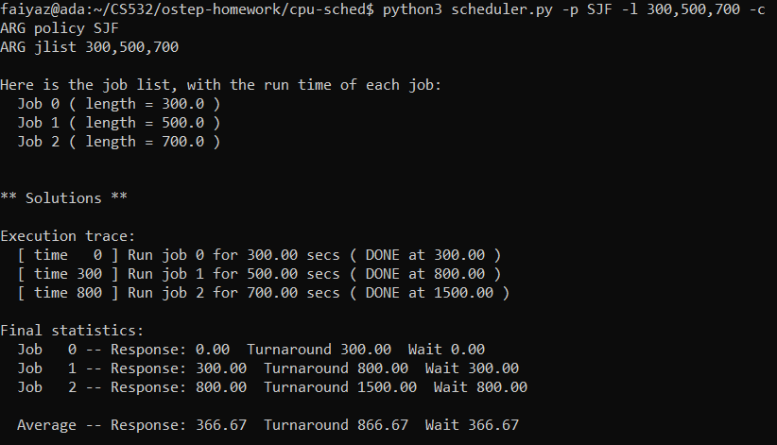
6. What happens to response time with SJF as job lengths increase? Can you use scheduler.py to demonstrate the trend?
Answer: The response time increases as the job length increases. This can be shown below clearly.
Good

Slide 10
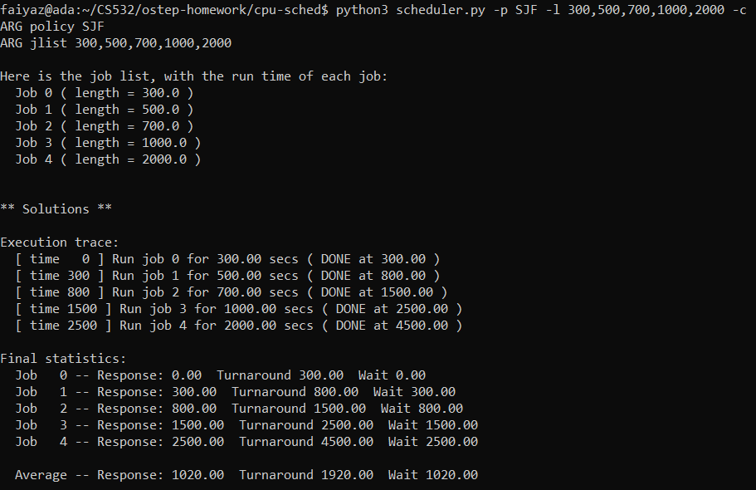
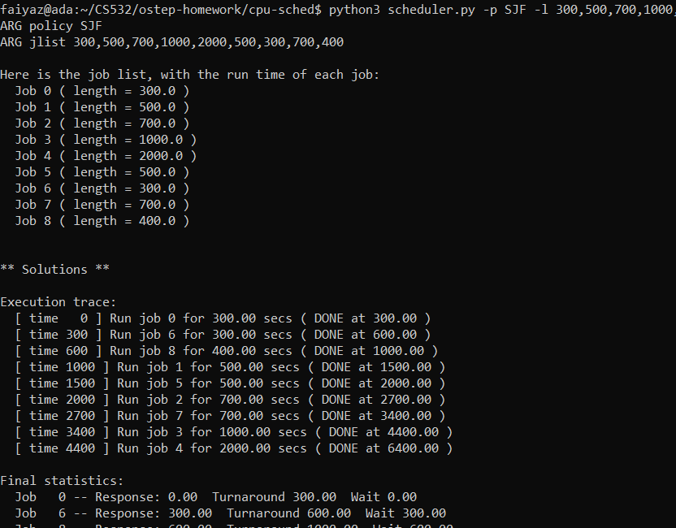

Slide 11
7. What happens to response time with RR as quantum lengths increase?
Provide an equation that gives the worst-case response time, given N jobs.
With the increase in quantum length, the response time increases monotonically.
With time quantum as Q, the equation for worst-case response time is Q(N-1)
Good

